Slide 1
compiler definition
compiler is software that convert hll code to lll code
hll code
lll code

Slide 2
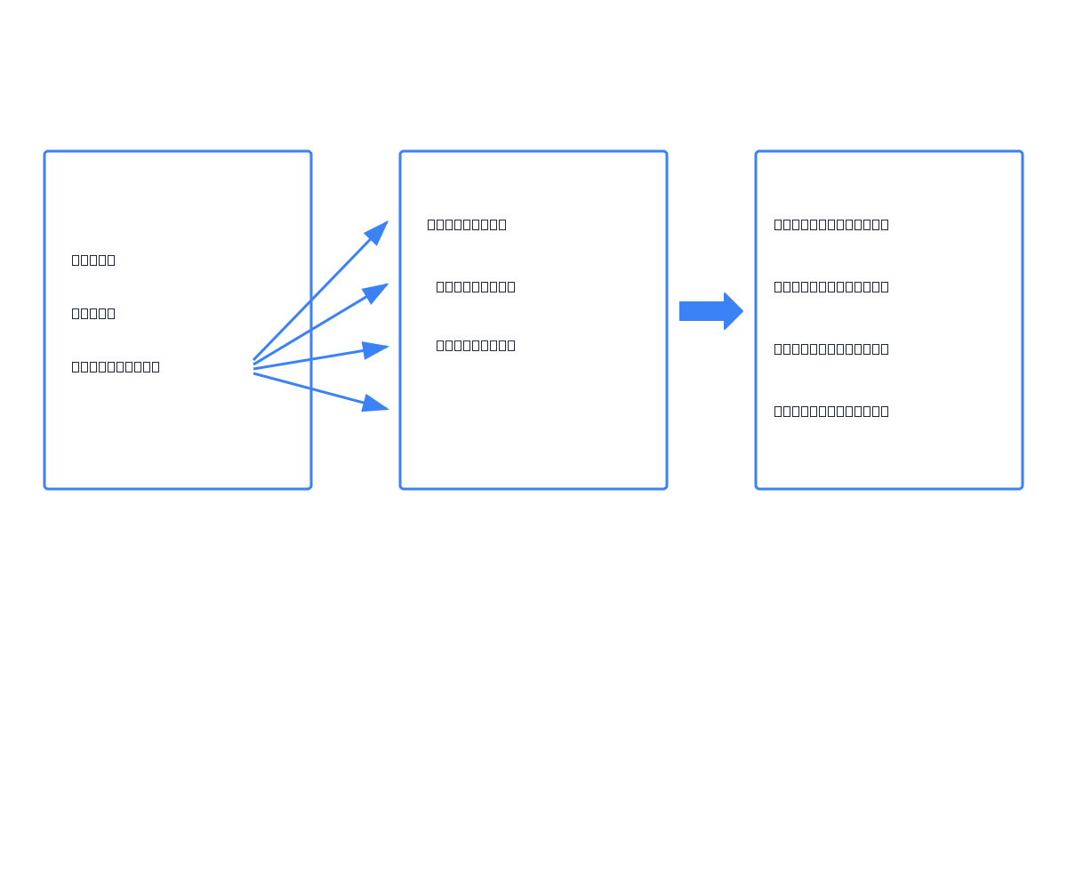

Slide 3
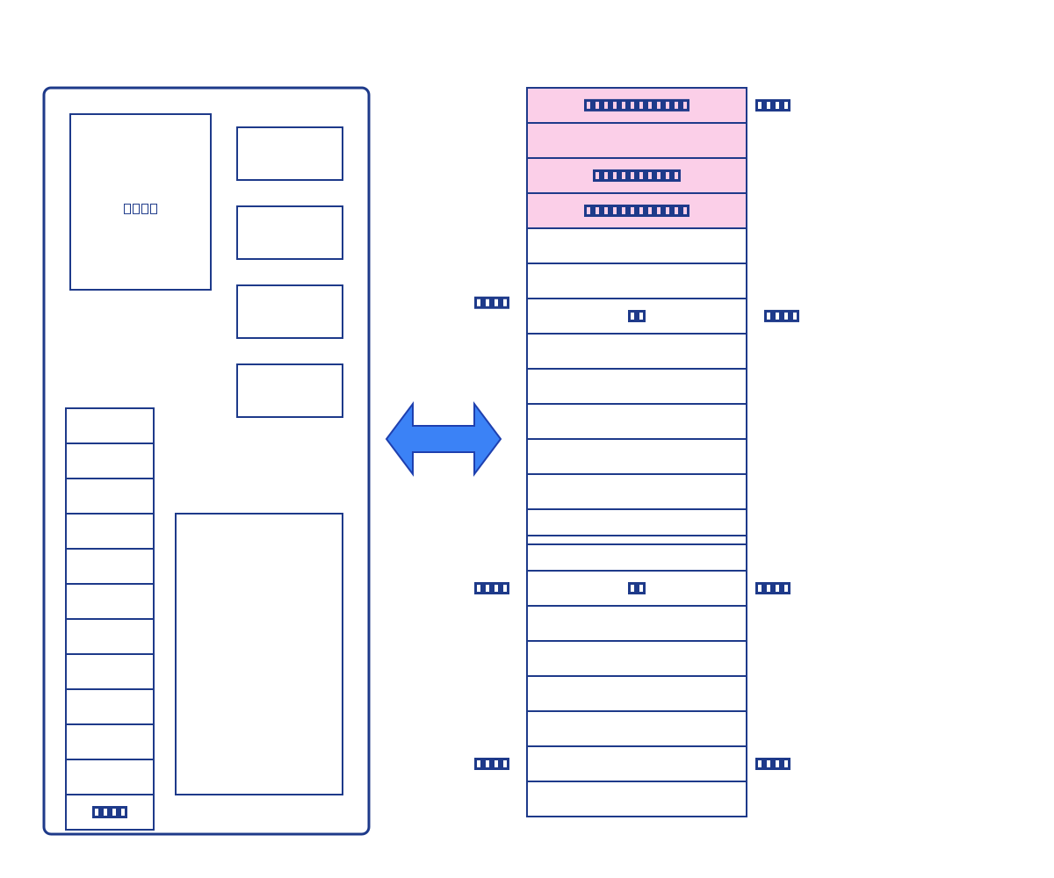

Slide 4
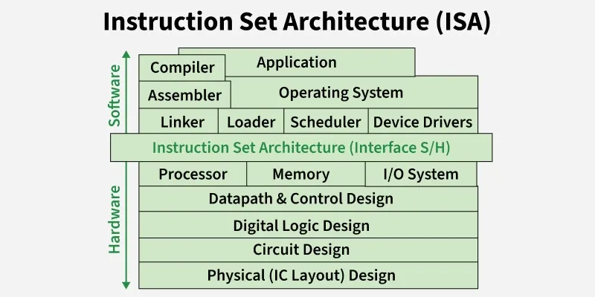

Slide 5
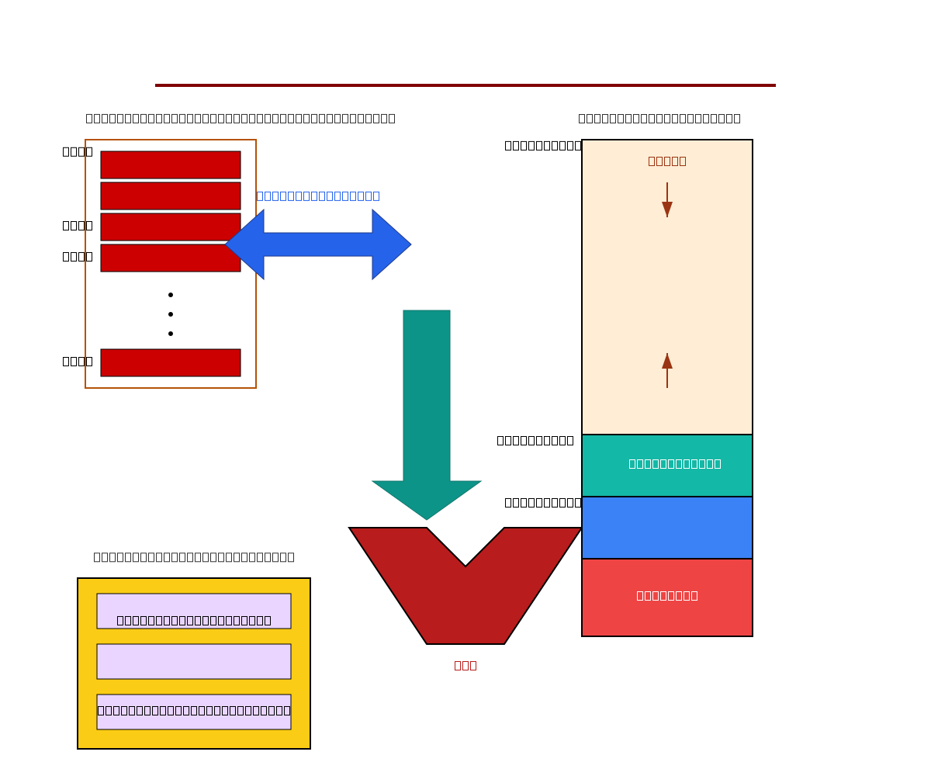

Slide 6
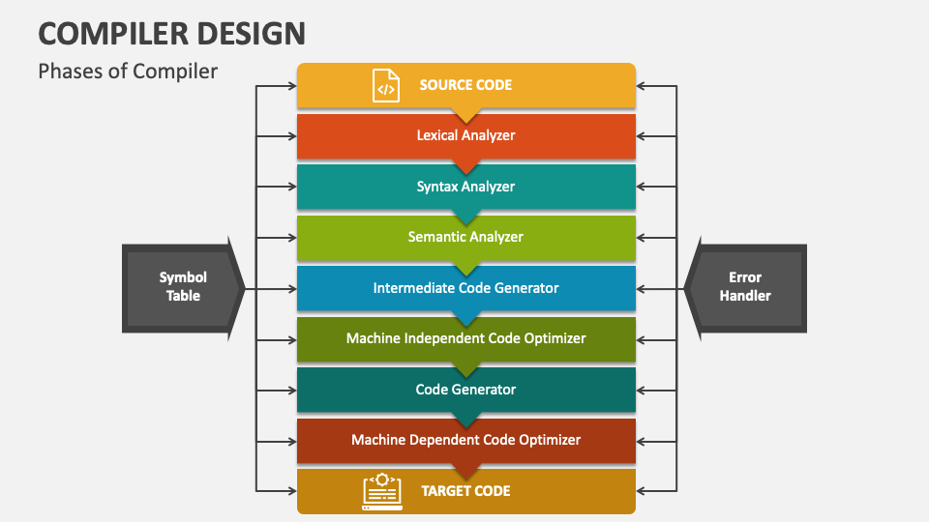

Slide 7
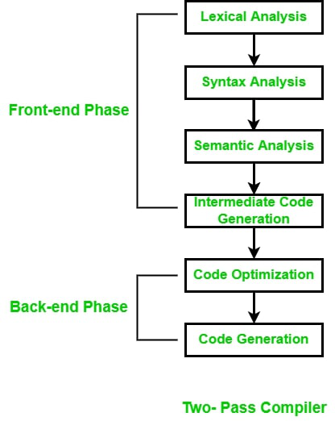

Slide 8
Compiler Construction
1. Define the Alphabet (Lexical Elements)
• Decide what characters are valid in your language:
• Letters: a-z, A-Z
• Digits: 0-9
• Symbols: + - * / = ( ) { } ; ,
• These form the tokens your compiler will recognize.
2. Design Keywords
• Reserve special words that have fixed meaning:
• Examples: if, else, while, return
• These cannot be used as variable names.

Slide 9
3. Specify Syntax & Grammar
• Define how statements are written:
• Assignment: x = 5;
• Input: read(x);
• Output: print(x);
4. Lexical Analysis
• Split input into tokens (keywords, identifiers, operators).
• Example: x = 5 + 3; → [ID: x] [=] [NUM: 5] [+] [NUM: 3] [;]

Slide 10
5. Syntax Analysis (Parsing)
• Check if tokens follow grammar rules.
• If not, throw an error.
• Example: read(x); must match the rule for input statements.
6. Intermediate Code Generation (IMC)
• Translate valid syntax into an intermediate representation.
• Example: x = 5 + 3; → IMC like t1 = 5 + 3; x = t1;

Slide 11
7. Code Generation
• Convert IMC into machine code or bytecode.
• Example: int x = 8; in C, or assembly instructions.
8. Optimization (Optional)
• Improve efficiency of generated code.
• Example: Replace redundant operations.

Slide 12
9. Testing & Error Handling
• Ensure compiler catches invalid syntax.
• Example: x = + ; → Error: unexpected operator.

Slide 13
conclusion
learning exists language → simple
creating new compiler → hard

Slide 14
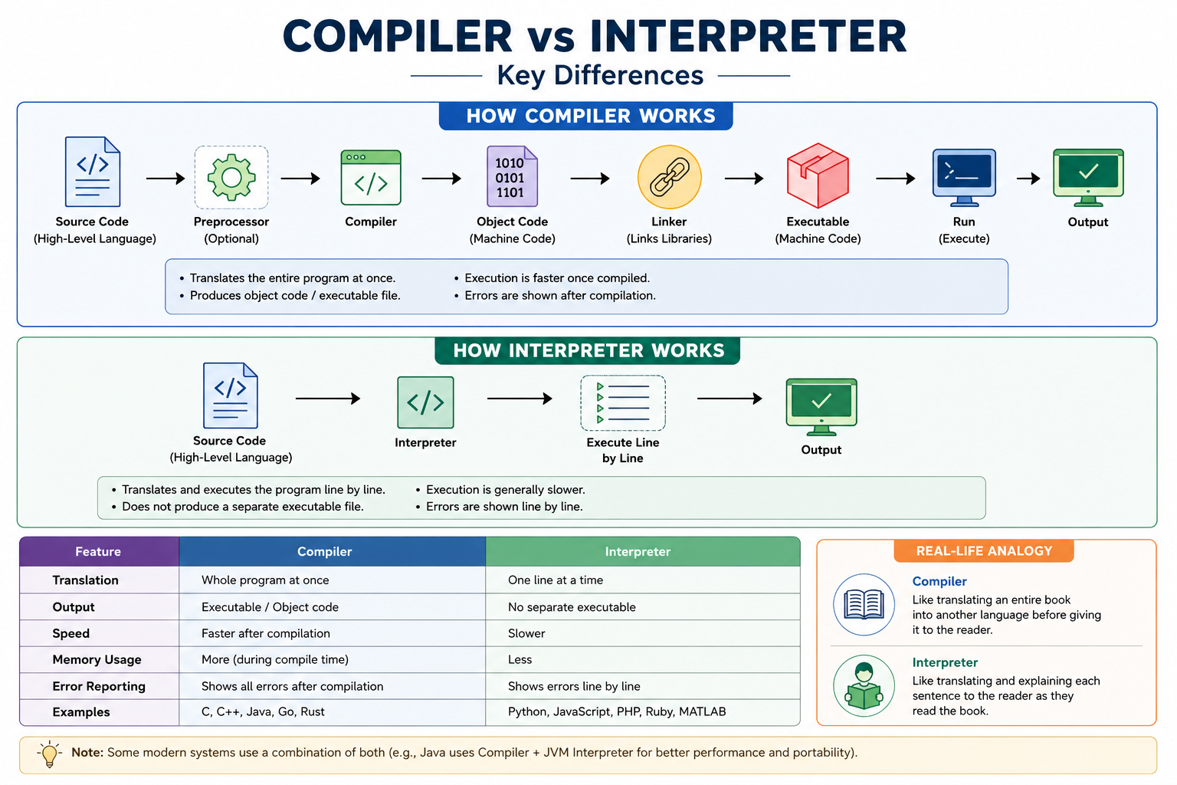

Slide 15
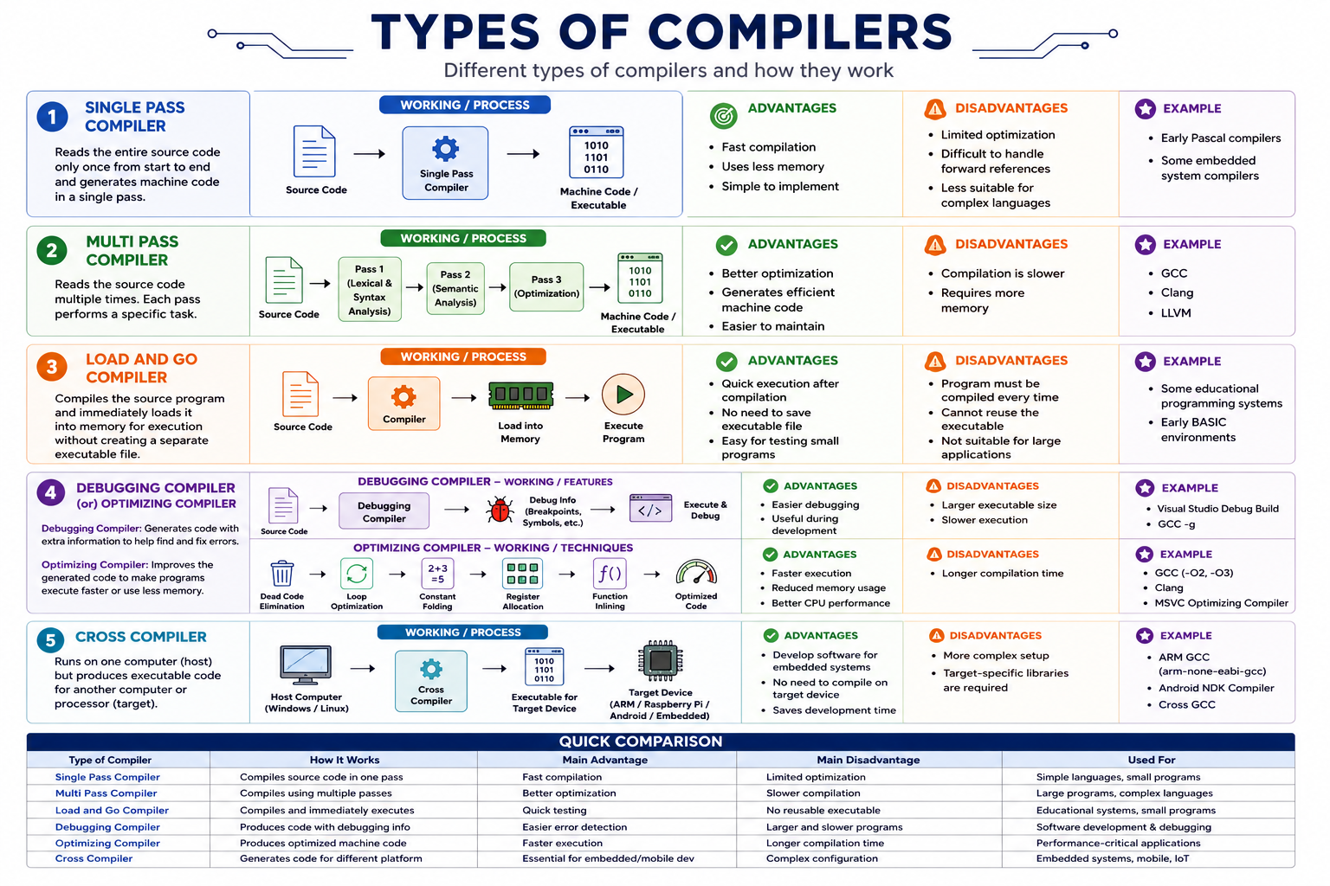

Slide 16
CLASSIFICATION OF COMPILER
1. Single Pass Compiler
2. Multi Pass Compiler
3. Load and Go
4. Debugging Compiler (or) Optimizing Compiler
5. Cross Compiler
LEXICAL ANALYZER
- It reads the source program one character at a time and grouped into tokens.
- The error handler is invoked when an error in the source program is detected.
- Each phase can encounter errors.

Slide 17
ERRORS IN EACH PHASE
- Lexical Analysis → unrecognized token
- Syntax Analysis → invalid syntactic structure
- Semantic Analysis → type mismatch
GROUPING OF PHASES
Front End : Machine Independent Phases
• Lexical Analysis
• Syntax Analysis
• Semantic Analysis
• Intermediate Code Generation
• Some Code Optimization
Back End : Machine Dependent Phases
• Code Generation
• Machine-Dependent Optimizations

Slide 18
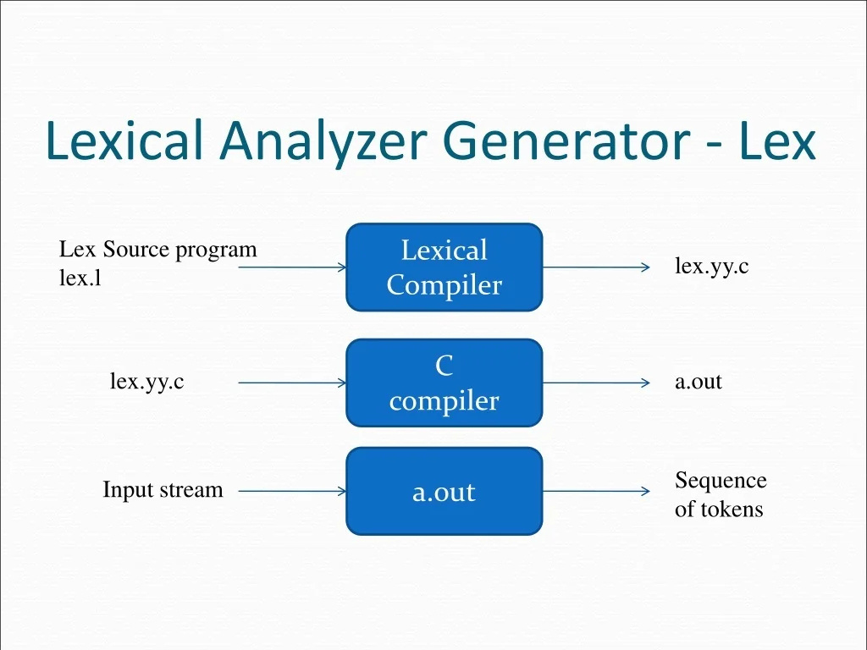

Slide 19
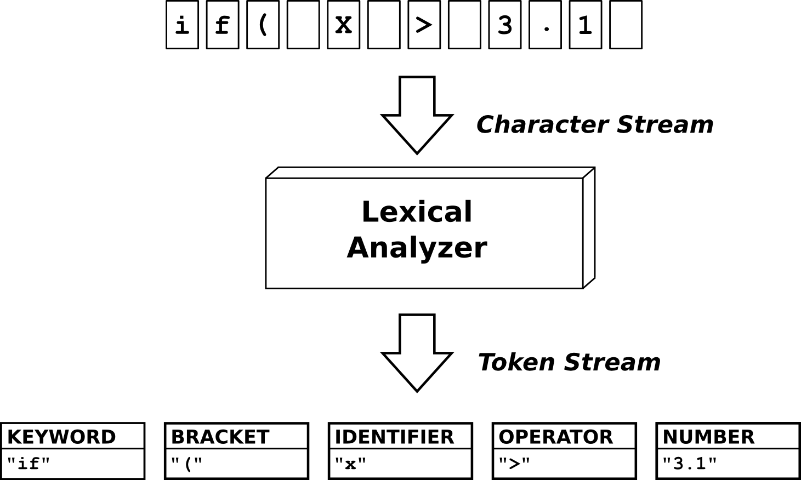

Slide 20
language rules → RE
it is syntax sub part
it will be checking process
for lex → token
token
automata
valid token
errors

Slide 21
What is a Finite Automaton?
the generalized transition diagram for regular expression is called finite automata
Two of finite automata
non deterministic finite automata (nfa)
deterministic finite automata (dfa)

Slide 22
Deterministic Finite Automaton vs Non deterministic Finite Automaton
DFA: One state → one input → exactly one next state.
NFA: One state → one input → possibly many next states (or none).
Regular expression → NFA → DFA → minimised DFA → scanner (Lexer)

Slide 23
Transition diagram for Identifiers in Compiler Design

Slide 24
what is Programming Language Grammar ?
Programming languages also need rules.
IT is valid : a = b + c;
IT is invalid : = a + b c;
Example Grammar
E → E + T
E → T
T → id
E = Expression
T = Term
id = Identifier

Slide 25
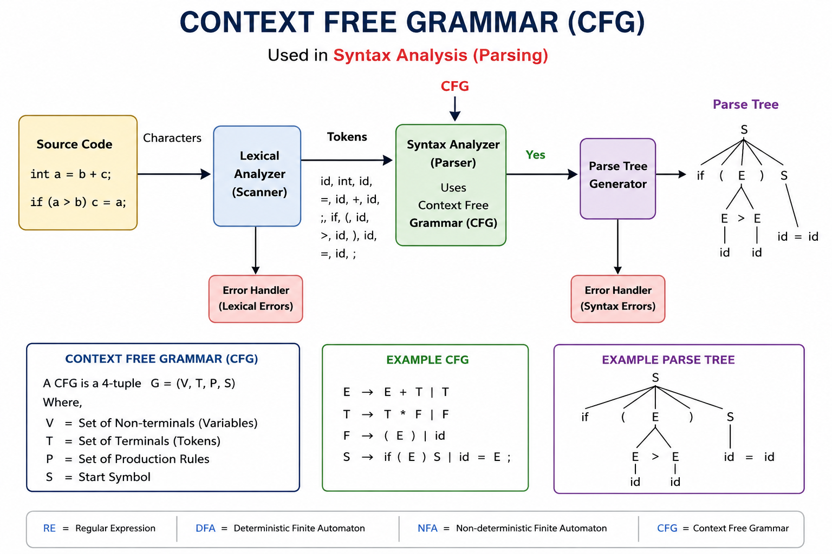

Slide 26
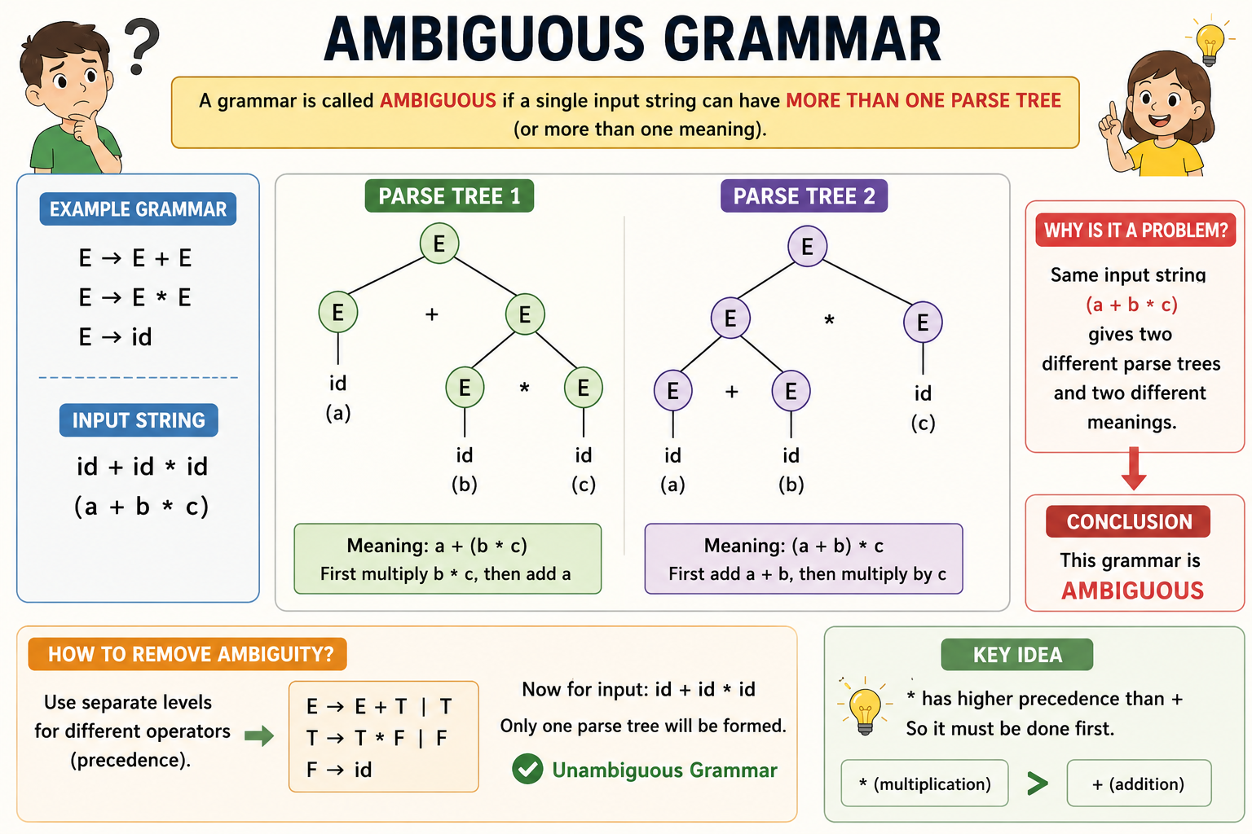

Slide 27
Semantic Analysis
Semantic Analysis is the compiler phase that checks whether the program's meaning is correct after the syntax has already been verified.

Slide 28
1. Type Checking
→ Checks data types are correct.
Example: int a; a = "Hello"; ❌
2. Declaration Checking
→ Checks variables are declared.
Example: x = 10; ❌ (x not declared)
3. Scope Checking
→ Checks variable visibility.
Example: Using local variable outside its block ❌
4. Function Checking
→ Checks function name, arguments, and types.
Example: add(10); ❌ (missing argument)
5. Return Type Checking
→ Checks returned value matches function type.
Example:
int fun() { return "Hello"; } ❌

Slide 29
Type Checking
1. Checks data type correctness.
2. Performed during Semantic Analysis.
3. Detects type mismatch errors.
4. Checks assignments, functions, and expressions.

Slide 30
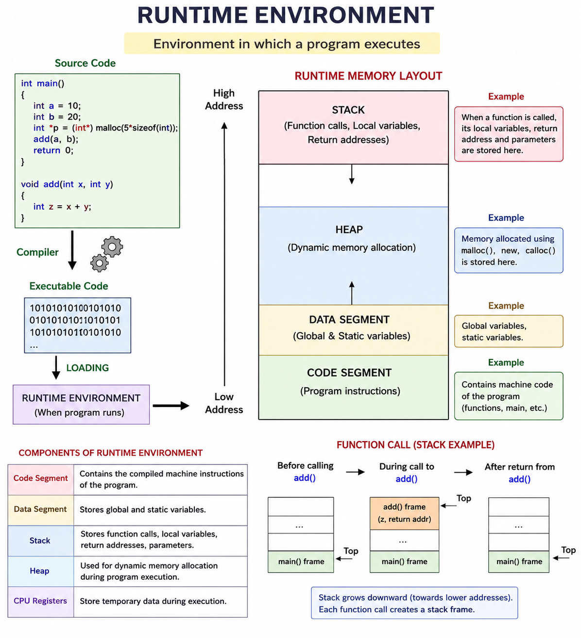

Slide 31
Three Address Code
Three Address Code (TAC) is an intermediate code representation in which each instruction contains at most three addresses and is used to simplify expressions for optimization and machine code generation.
Source Code
↓
Lexical Analysis
↓
Syntax Analysis
↓
Semantic Analysis
↓
Three Address Code (TAC)
↓
Code Optimization
↓
Machine Code
complier can create Temporary Variables like
t1
t2
t3
...

Slide 32
Code Optimization
1. Improves Program Speed
→ Program runs faster.
2. Reduces Memory Usage
→ Uses less RAM.
3. Removes Unnecessary Code
→ Deletes useless statements.
4. Reduces CPU Work
→ Fewer instructions to execute.
5. Keeps Same Output
→ Result does not change.

Slide 33
Directed Acyclic Graph (DAG)
A DAG (Directed Acyclic Graph) is a graph used in Code Optimization to represent expressions and find repeated computations.
DAG Representation
1. DAG = Directed Acyclic Graph.
2. Used in Code Optimization.
3. Represents expressions as a graph.
4. Eliminates common subexpressions.
5. Improves execution speed.
(+)
/ \
b c
/ \
a d
a = b + c
d = b + c

Slide 34
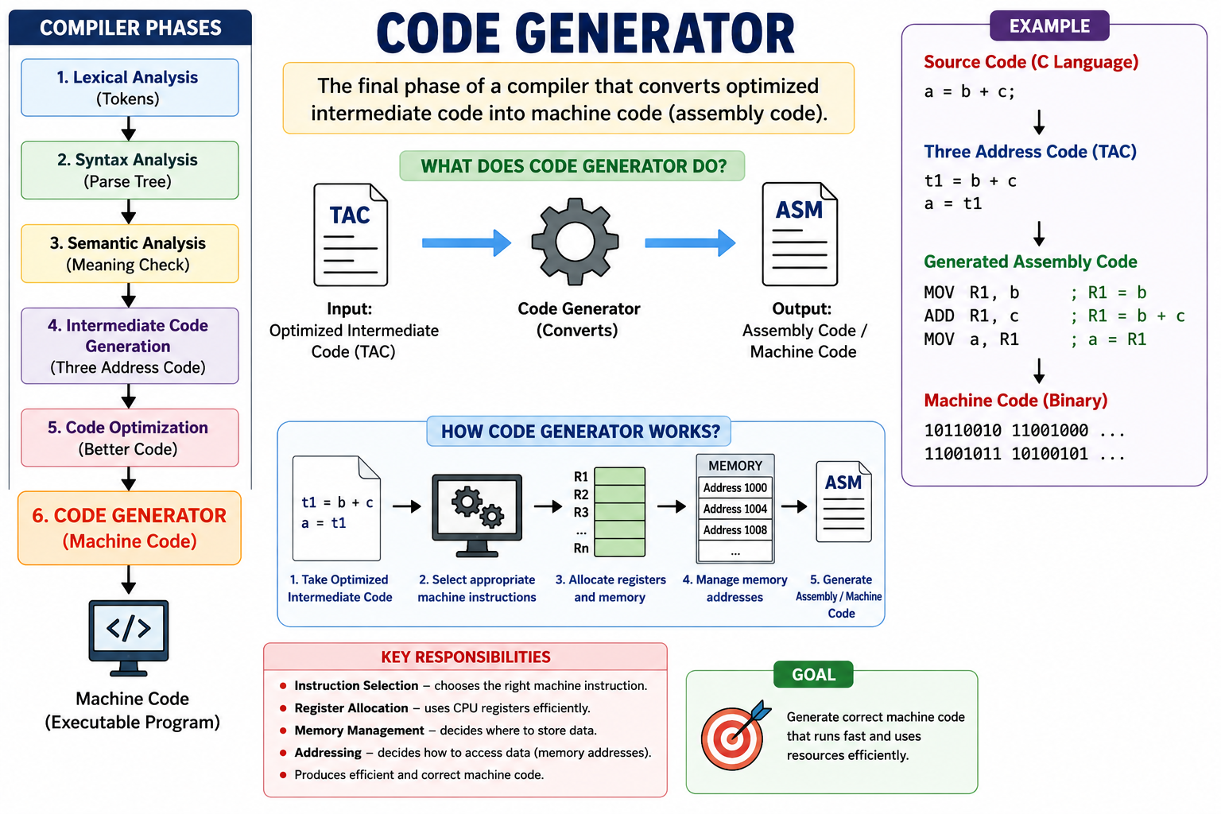

Slide 35
Non deterministic finite automata (NFA)
Thompson's construction
Conversion Rules of Regular Expressions to Finite Automata
online visual 1
online visual 2
online visual 3
online visual 4

Slide 36
Deterministic Finite Automaton (DFA)
online visual 1
online visual 2
online visual 3

Slide 37
PARSER TREE - COMPILER DESIGN
online visual 1

Slide 38
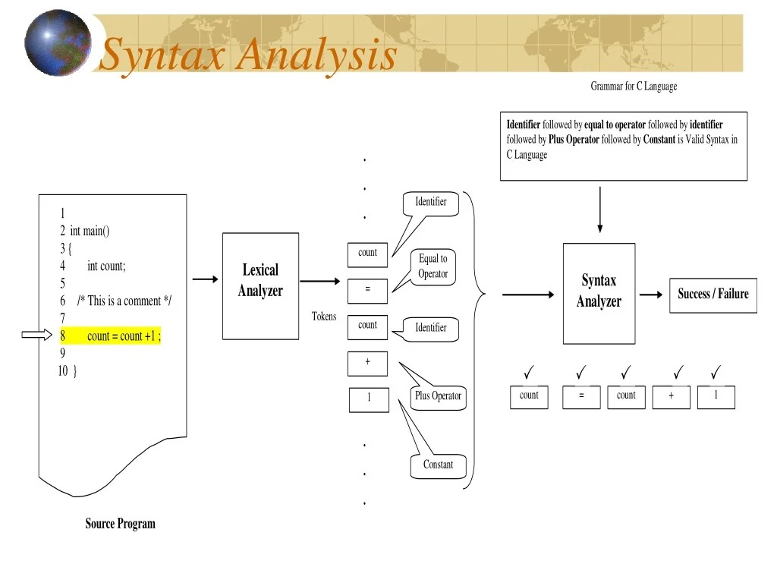

Slide 39
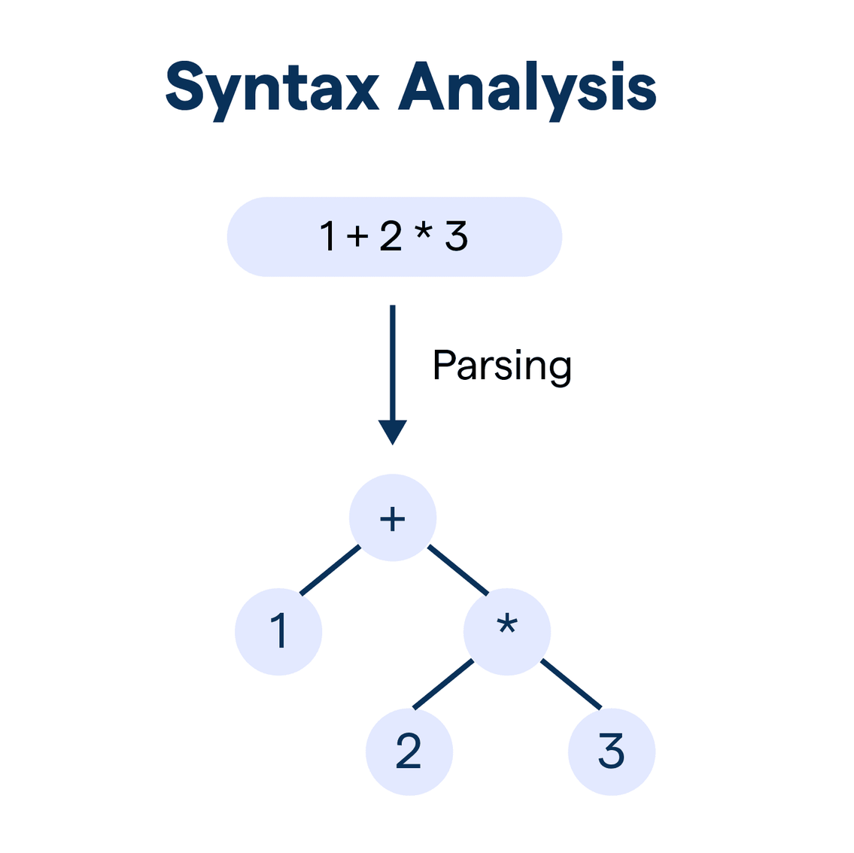

Slide 40
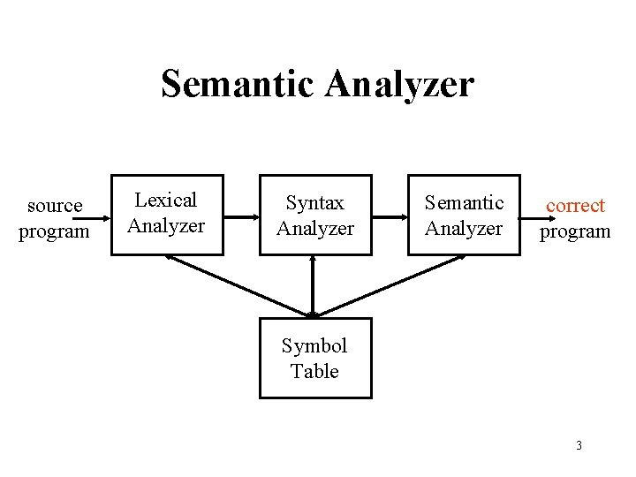

Slide 41
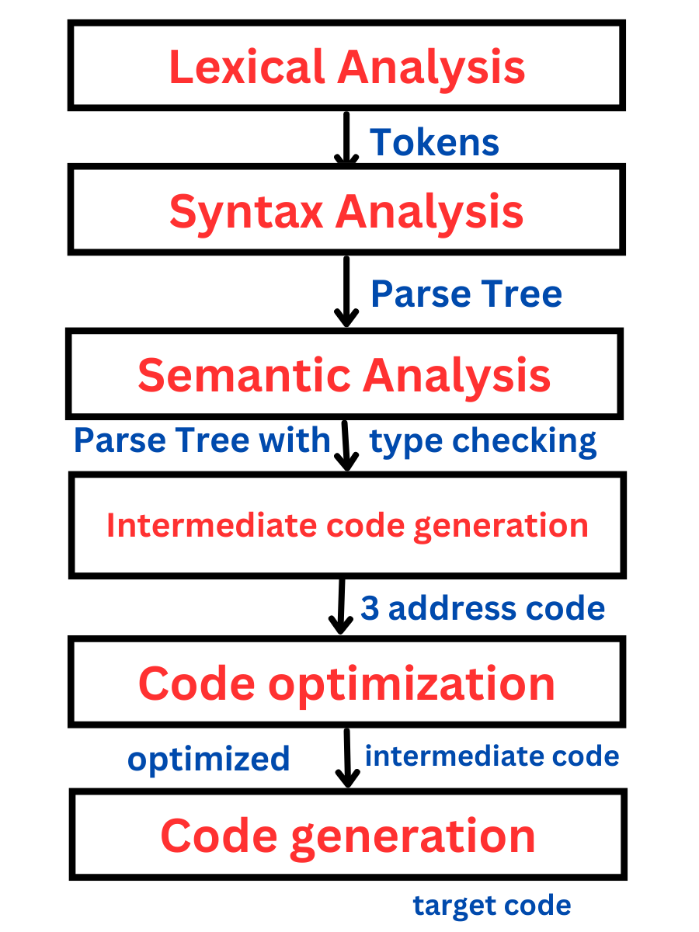

Slide 42
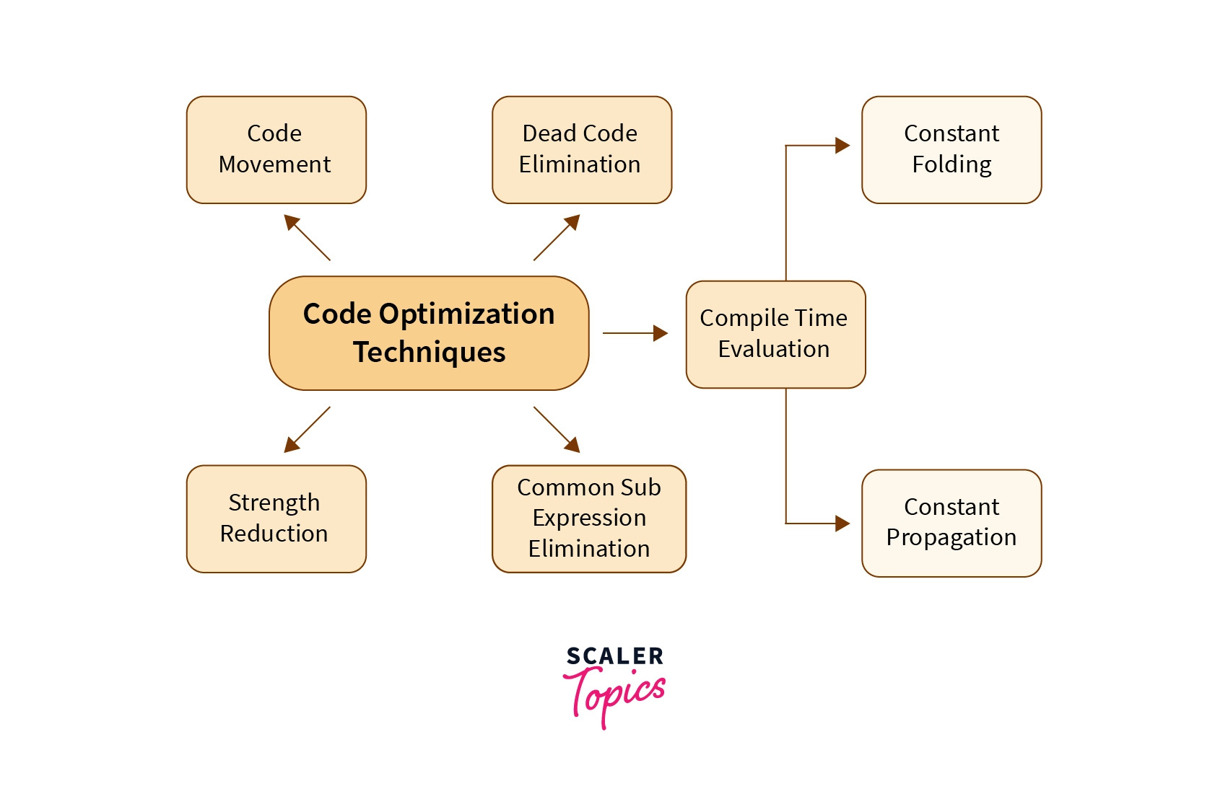

Slide 43
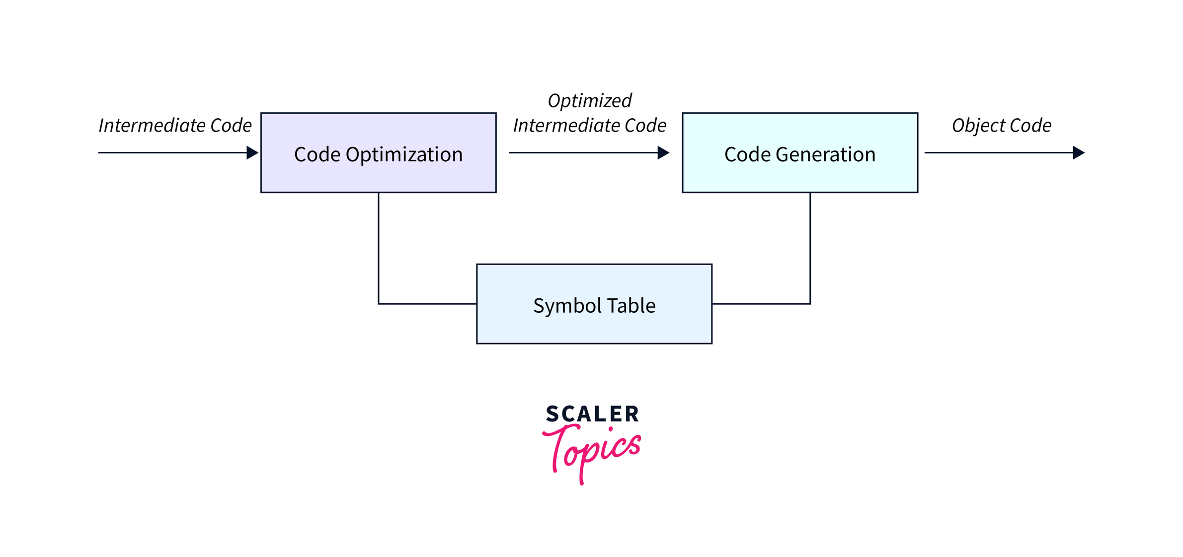

Slide 44
